Slide 1

Creating a Weather App in Your Terminal with Python
Mike Driscoll
Get Slides and Code here:
https://github.com/driscollis/talks

Slide 2
What We’re Talking About
Terminal Packages for Python
What is Textual
Installing Textual
Hello World
Getting Weather Data
Creating the Weather App
Questions

Slide 3
Terminal Packages for Python
Curses (standard library)
Asciimatics
Textual

Slide 4
What is Textual?
Textual is a Rapid Application Development framework for Python, built by Textualize.io.
Build sophisticated user interfaces with a simple Python API. Run your apps in the terminal or a web browser!
Learn more here: https://textual.textualize.io/

Slide 5
Installing Textual + Dependencies
01
Open a terminal or command prompt
02
Run the following command:
python -m pip install –r requirements.txt
03
You’re ready to code!

Slide 6
Getting Weather Data
Weather.gov
OpenWeatherMap
Open Mateo

Slide 7

Creating the Weather App

Slide 8
Questions?

Slide 9
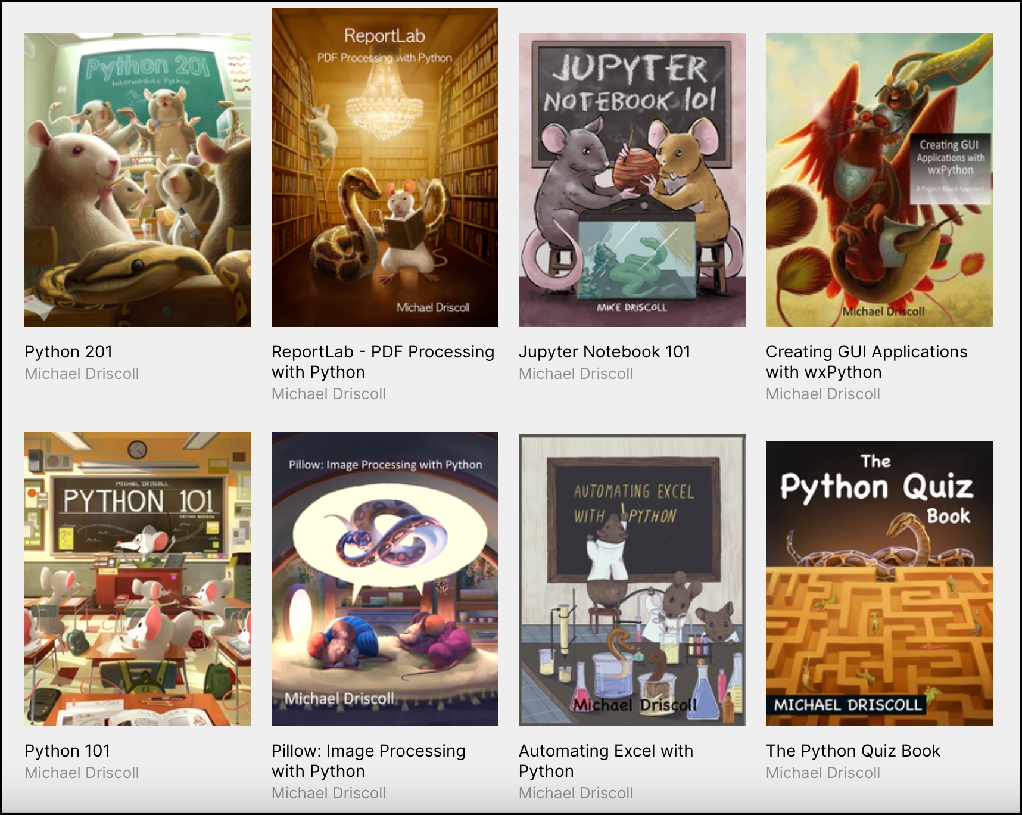
Thank you!
https://github.com/driscollis/talks
Learn More Python
Get Code and Slide Here:
https://github.com/driscollis/talks
- MouseVsPython.com
- @driscollis on X, Mastodon, and BlueSky
https://driscollis.gumroad.com/

